Slide 1
Discrete Mathematics Lecture #2

Slide 2
Propositional Equivalences

Slide 3
Some Common Terms
Tautology
A compound proposition that is always true, no matter what the truth values of the propositional variables that occur in it, is called a tautology.
Contradiction
A compound proposition that is always false is called a contradiction.
Contingency
A compound proposition that is neither a tautology nor a contradiction is called a contingency.

Slide 4
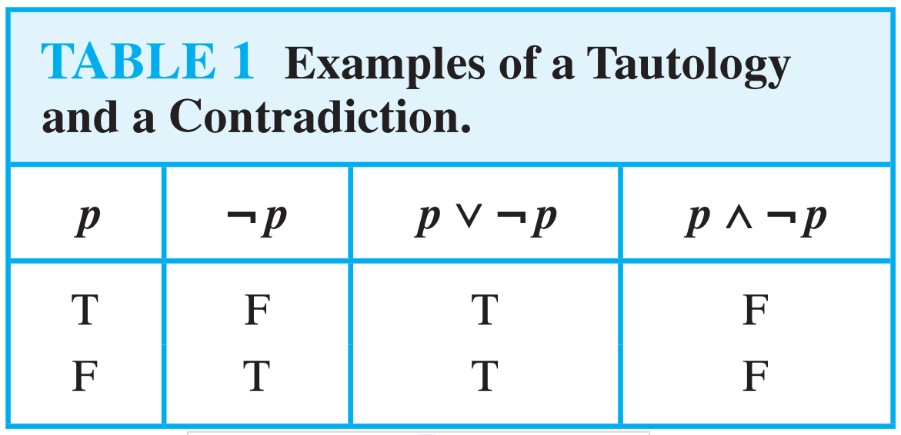
Example
Tautology
p ∨ ¬p
Contradiction
p ∧ ¬p
Contingency
p → ¬p

Slide 5
Tautology
Demonstrate that
[¬p ∧(p ∨q )]→q
is a tautology in two ways:
Using a truth table – show that [¬p ∧(p ∨q )]→q is always true
Using a proof (will get to this later).

Slide 6
Tautology by truth table
p | q | ¬p | p ∨q | ¬p ∧(p ∨q ) | [¬p ∧(p ∨q )]→q
T | T
T | F
F | T
F | F

Slide 7
Tautology by truth table
p | q | ¬p | p ∨q | ¬p ∧(p ∨q ) | [¬p ∧(p ∨q )]→q
T | T | F | T | F | T
T | F | F | T | F | T
F | T | T | T | T | T
F | F | T | F | F | T

Slide 8
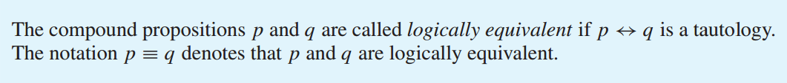
Propositional Equivalences
Definition
Compound propositions that have the same truth values in all possible cases are called logically equivalent.

Slide 9
Propositional Equivalences : How to Prove?
Two methods:
Using truth tables
Not good for long formula
In this course, only allowed if specifically stated!
Using the logical equivalences
The preferred method
p →q ≡ ¬q→¬p
(p → r) ∨ (q → r) ≡ (p ∧ q) → r

Slide 10
Logical Equivalence Using Truth Table
The easiest way to check for logical equivalence is to see if the truth tables of both variants have
identical last columns. (p →q ≡ ¬q→¬p)
p
q
p →q
p
q
¬q
¬p
¬q→¬p

Slide 11
Logical Equivalence Using Truth Table
The easiest way to check for logical equivalence is to see if the truth tables of both variants have identical last columns:
p
q
p →q
p
q
¬q
¬p
¬q→¬p
T
T
F
F
T
F
T
F
T
F
T
T

Slide 12
Logical Equivalence Using Truth Table
The easiest way to check for logical equivalence is to see if the truth tables of both variants have identical last columns:
p
q
p →q
p
q
¬q
¬p
¬q→¬p
T
T
F
F
T
F
T
F
T
F
T
T
T
T
F
F
T
F
T
F

Slide 13
Logical Equivalence Using Truth Table
The easiest way to check for logical equivalence is to see if the truth tables of both variants have identical last columns:
p
q
p →q
p
q
¬q
¬p
¬q→¬p
T
T
F
F
T
F
T
F
T
F
T
T
T
T
F
F
T
F
T
F
F
T
F
T

Slide 14
Logical Equivalence Using Truth Table
The easiest way to check for logical equivalence is to see if the truth tables of both variants have identical last columns:
p
q
p →q
p
q
¬q
¬p
¬q→¬p
T
T
F
F
T
F
T
F
T
F
T
T
T
T
F
F
T
F
T
F
F
T
F
T
F
F
T
T

Slide 15
Logical Equivalence Using Truth Table
The easiest way to check for logical equivalence is to see if the truth tables of both variants have identical last columns:
p
q
p →q
p
q
¬q
¬p
¬q→¬p
T
T
F
F
T
F
T
F
T
F
T
T
T
T
F
F
T
F
T
F
F
T
F
T
F
F
T
T
T
F
T
T

Slide 16
Truth Table Solution
(p → r) ∨ (q → r) ≡ (p ∧ q) → r
p | q | r | p→r | q →r | p∧q | (p→r)∨(q →r) | (p∧q) →r
T | T | T | T | T | T | T | T
T | T | F | F | F | T | F | F
T | F | T | T | T | F | T | T
T | F | F | F | T | F | T | T
F | T | T | T | T | F | T | T
F | T | F | T | F | F | T | T
F | F | T | T | T | F | T | T
F | F | F | T | T | F | T | T

Slide 17
Logical Equivalences
p ∧ T ≡ p p ∨ F ≡ p | Identity Laws | (p ∨ q) ∨ r ≡ p ∨ (q ∨ r) (p ∧ q) ∧ r ≡ p ∧ (q ∧ r) | Associative laws
p ∨ T ≡ T p ∧ F ≡ F | Domination Law | p ∨ (q ∧ r) ≡ (p ∨ q) ∧ (p ∨ r) p ∧ (q ∨ r) ≡ (p ∧ q) ∨ (p ∧ r) | Distributive laws
p ∨ p ≡ p p ∧ p ≡ p | Idempotent Laws | ¬ (p ∧ q) ≡ ¬ p ∨ ¬ q ¬ (p ∨ q) ≡ ¬ p ∧ ¬ q | De Morgan’s laws
¬(¬ p) ≡ p | Double negation law | p ∨ (p ∧ q) ≡ p p ∧ (p ∨ q) ≡ p | Absorption laws
p ∨ q ≡ q ∨ p p ∧ q ≡ q ∧ p | Commutative Laws | p ∨ ¬ p ≡ T p ∧ ¬ p ≡ F | Negation lows
p→q ≡ ¬p∨q | Definition of Implication | p ↔ q ≡ (p → q) ∧ (q → p) | Definition of Biconditional

Slide 18
Example
Logical Equivalences : Example
Show that (p ∧ q) → (p ∨ q) is a Tautology. (Proof)
(p ∧ q) → (p ∨ q)
≡¬ (p ∧ q) ∨ (p ∨ q) Implication
≡ (¬ p ∨ ¬ q) ∨ (p ∨ q) De Morgan
≡ (¬ p ∨ p) ∨ (¬ q ∨ q) Commutative, Associative
≡ T ∨ T Negation
≡ T Identity

Slide 19
Tautology by proof
Tautology by proof
[¬p ∧(p ∨q )]→q
⇔ [(¬p ∧p)∨(¬p ∧q)]→q Distributive

Slide 20
Tautology by proof
Tautology by proof
[¬p ∧(p ∨q )]→q
⇔ [(¬p ∧p)∨(¬p ∧q)]→q Distributive
⇔ [ F ∨ (¬p ∧q)]→q

Slide 21
Tautology by proof
Tautology by proof
[¬p ∧(p ∨q )]→q
⇔ [(¬p ∧p)∨(¬p ∧q)]→q Distributive
⇔ [ F ∨ (¬p ∧q)]→q
⇔ [¬p ∧q ]→q Identity

Slide 22
Tautology by proof
Tautology by proof
[¬p ∧(p ∨q )]→q
⇔ [(¬p ∧p)∨(¬p ∧q)]→q Distributive
⇔ [ F ∨ (¬p ∧q)]→q
⇔ [¬p ∧q ]→q Identity
⇔ ¬ [¬p ∧q ] ∨ q Definition of implication

Slide 23
Tautology by proof
Tautology by proof
[¬p ∧(p ∨q )]→q
⇔ [(¬p ∧p)∨(¬p ∧q)]→q Distributive
⇔ [ F ∨ (¬p ∧q)]→q
⇔ [¬p ∧q ]→q Identity
⇔ ¬ [¬p ∧q ] ∨ q Definition of implication ⇔ [¬(¬p)∨ ¬q ] ∨ q DeMorgan

Slide 24
Tautology by proof
Tautology by proof
[¬p ∧(p ∨q )]→q
⇔ [(¬p ∧p)∨(¬p ∧q)]→q Distributive
⇔ [ F ∨ (¬p ∧q)]→q
⇔ [¬p ∧q ]→q Identity
⇔ ¬ [¬p ∧q ] ∨ q Definition of implication ⇔ [¬(¬p)∨ ¬q ] ∨ q DeMorgan
⇔ [p ∨ ¬q ] ∨ q Double Negation

Slide 25
Tautology by proof
Tautology by proof
[¬p ∧(p ∨q )]→q
⇔ [(¬p ∧p)∨(¬p ∧q)]→q Distributive
⇔ [ F ∨ (¬p ∧q)]→q
⇔ [¬p ∧q ]→q Identity
⇔ ¬ [¬p ∧q ] ∨ q Definition of implication
⇔ [¬(¬p)∨ ¬q ] ∨ q DeMorgan
⇔ [p ∨ ¬q ] ∨ q Double Negation
⇔ p ∨ [¬q ∨q ] Associative

Slide 26
Tautology by proof
Tautology by proof
[¬p ∧(p ∨q )]→q
⇔ [(¬p ∧p)∨(¬p ∧q)]→q Distributive
⇔ [ F ∨ (¬p ∧q)]→q
⇔ [¬p ∧q ]→q Identity
⇔ ¬ [¬p ∧q ] ∨ q Definition of implication
⇔ [¬(¬p)∨ ¬q ] ∨ q DeMorgan
⇔ [p ∨ ¬q ] ∨ q Double Negation
⇔ p ∨ [¬q ∨q ] Associative
⇔ p ∨ [q ∨¬q ] Commutative

Slide 27
Tautology by proof
Tautology by proof
[¬p ∧(p ∨q )]→q
⇔ [(¬p ∧p)∨(¬p ∧q)]→q Distributive
⇔ [ F ∨ (¬p ∧q)]→q
⇔ [¬p ∧q ]→q Identity
⇔ ¬ [¬p ∧q ] ∨ q Definition of implication
⇔ [¬(¬p)∨ ¬q ] ∨ q DeMorgan
⇔ [p ∨ ¬q ] ∨ q Double Negation
⇔ p ∨ [¬q ∨q ] Associative
⇔ p ∨ [q ∨¬q ] Commutative
⇔ p ∨ T

Slide 28
Tautology by proof
Tautology by proof
[¬p ∧(p ∨q )]→q
⇔ [(¬p ∧p)∨(¬p ∧q)]→q Distributive
⇔ [ F ∨ (¬p ∧q)]→q
⇔ [¬p ∧q ]→q Identity
⇔ ¬ [¬p ∧q ] ∨ q Definition of implication
⇔ [¬(¬p)∨ ¬q ] ∨ q DeMorgan
⇔ [p ∨ ¬q ] ∨ q Double Negation
⇔ p ∨ [¬q ∨q ] Associative
⇔ p ∨ [q ∨¬q ] Commutative
⇔ p ∨ T
⇔ T Domination

Slide 29
Thank you

